Slide 1
Case Study 2: Employee Attrition
Michael Burgess

Slide 2
Project Background
Project sponsored by DDSAnalytics, a talent management firm
Looking to leverage data science
Executive leadership has asked for proof of concept:
Identify the top 3 factors contributing to attrition
Predict attrition with at least 60% accuracy
Identify the top 3 factors contributing to monthly income
Predict monthly income with less than $3,000 in error

Slide 3
The Data
Provided by DDSAnalytics
Contains information on 870 employees
36 columns containing information about employees such as Job Satisfaction, Job Role, and Job Level
Dropped unneeded columns such as Over 18 and Standard Hours
Very unbalanced rate of attrition:
Approximately 84% No Attrition Experienced
Approximately 16% Yes Attrition Experienced
Classifying all employees as No Attrition still results in almost 85% accuracy
Model good on paper, not in reality
Undersampling helps to resolve accuracy issues
Take out the 140 Yes Attrition employees and randomly sample 140 No Attrition employees

Slide 4
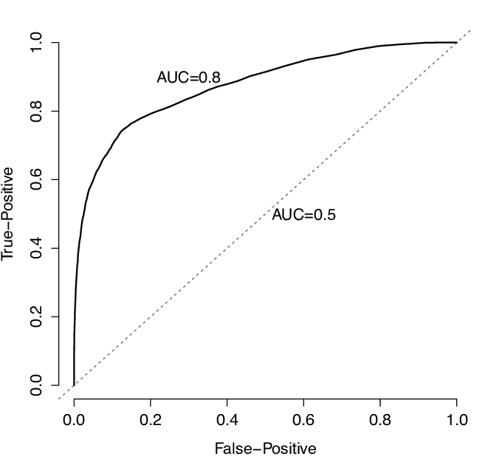
Predicting Attrition
How can we identify the top 3 contributors to attrition?
Naïve Bayes uses the probability of other events to predict the probability of attrition
Run Naïve Bayes 100 times using all variables in the undersampled dataset
Find the accuracy of each variable using Receiver Operating Characteristic Curve (ROC Curve)
The area under the curve compares true positives to false positives
The closer to 1 the area under the curve is, the more accurately the model predicts true positives
Save the top 3 variables from each model run
Count the number of times each variable appears in the top 3
Overtime, Monthly Income, and Total Years Worked were then identified as the most influential variables
An example of ROC curve in the case of AUC=0.8 and AUC=0.5 | Download Scientific Diagram (researchgate.net)

Slide 5
Predicting Attrition
Create a Naïve Bayes model with the undersampled data that only uses Overtime, Monthly Income, and Total Years Worked to make predictions about attrition
Run the model against the entire data set 100 times to generate average accuracy results
Using Overtime, Monthly Income, and Total Years Worked produced the following results over the 100 Naïve Bayes model runs:
71% overall mean accuracy
72% of No Attrition employees identified as No Attrition
64% of Yes Attrition employees identified as Yes Attrition
This supports our intuition:
Employees who feel over worked or under paid are more likely to experience turn over

Slide 6
Attrition Insights
Looking deeper at attrition caused by Overtime, Monthly Income, and Total Years Worked
Highest rates occur for employees with less than 5 total years of work experience
Sales Representatives have an attrition rate of over 45%:
Over 33% worked overtime
Only 1 had a monthly income over $5,000
Majority have less than 5 total years of work experience
Research Directors only had an attrition rate of 1.96%:
31% worked overtime
All had monthly incomes over $10,000
Almost all had more than 10 years of work experience
Again, we see evidence that the highest attrition occurs among employees who aren’t locked into their career yet and who feel overworked and underpaid

Slide 7
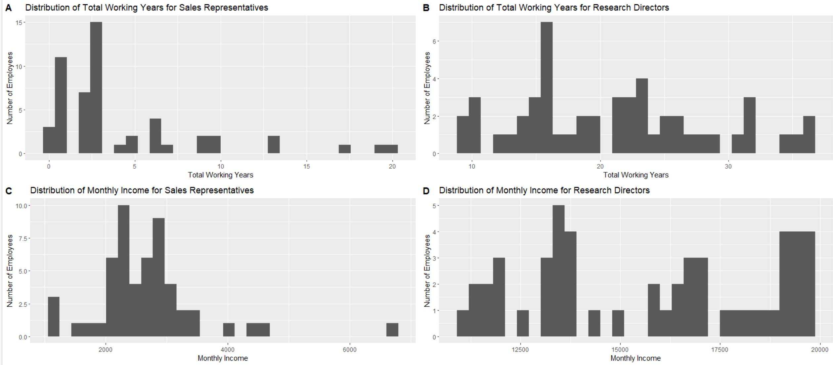
Attrition Insights

Slide 8
Predicting Monthly Income
How can we identify the top 3 contributors to Monthly Income?
Linear regression model using all variables was created
3 different automatic variable selection techniques were used
All 3 models agreed on Job Level, Job Role, And Total Working Years as the best predictors of Monthly Income (p-values < .0001)
A linear model created with only Job Level, Job Role, and Total Working Years predicted mean Monthly Income with an error of plus or minus $986.70.
This matches our expectations: The more experienced and more senior someone is, the higher their income is expected to be

Slide 9
Conclusions
Asked to identify top 3 factors causing attrition
Overtime, Monthly Income, and Total Years Worked
Found using Naïve Bayes and ROC analysis
Able to predict attrition with 71% accuracy using Naïve Bayes model consisting of Overtime, Monthly Income, and Total Years Worked
Asked to identify top 3 factors that determine monthly income
Job Level, Job Role, And Total Working Years
Found using automatic variable selection and linear regression
Able to predict monthly income within $986.70 using Linear Regression model consisting of Job Level, Job Role, And Total Working Years

Slide 10
Thank you for your time

Slide 11
Youtube Presentation Link
https://youtu.be/MmvPaYlUu78

